Slide 1


Face liveness detection
Biware solution
work produced by Daoud Aymen
work supervised by : Nadia Jmour PHD specialist in AI

Slide 2


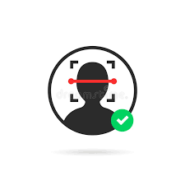

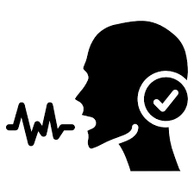
Recap
Liveness detection
Face matching
OCR
Voice identification and recognition
Stage ouvrier

Slide 3
Why we need face liveness detection?
Consider what would happen if a nefarious user tried to purposely circumvent your face recognition system.
Such a user could try to hold up a photo of another person. Maybe they even have a photo or video on their smartphone that they could hold up to the camera responsible for performing face In those situations it’s entirely possible for the face held up to the camera to be correctly recognized…but ultimately leading to an unauthorized user by passing your face recognition system!
-How would you go about spotting these “fake” versus “real/legitimate” faces? How could you apply anti-face spoofing algorithms into your facial recognition applications?

Slide 4
Face liveness detection
Method 1
Build the image dataset itself.
Implement a CNN capable of performing liveness detector (we’ll call this network “LivenessNet”).
Train the liveness detector network.
Create a Python + OpenCV script capable of taking our trained liveness detector model and apply it to real-time video.
Method 2
Create a Python + OpenCV script capable of eye blinking detector in real-time video

Slide 5

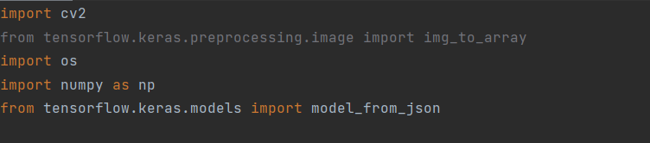
Face liveness detection
Method 1
Import libraries

Slide 6
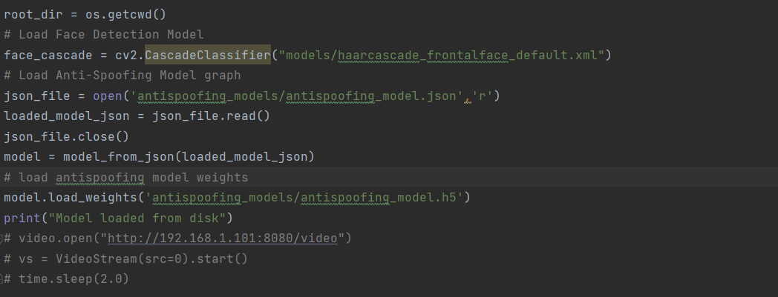
import our required packages. This script requires OpenCV, Os, Tensorflow and NumPy.
Face liveness detection

Slide 7
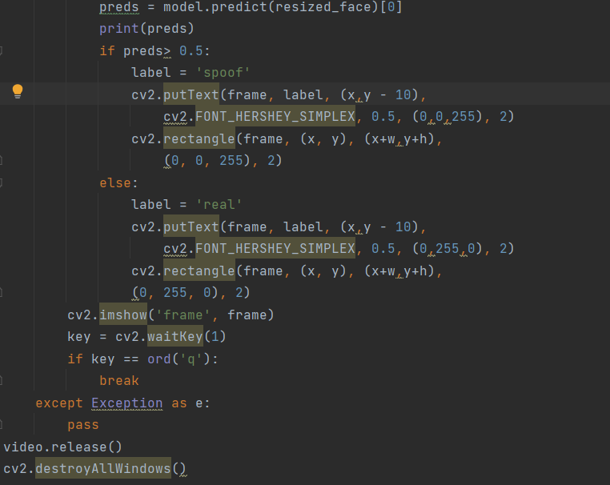
he face detection model, pretrained network graph and weights file of an antispoofing model is loaded into the disk for doing prediction in the live webcam data.
Face liveness detection

Slide 8
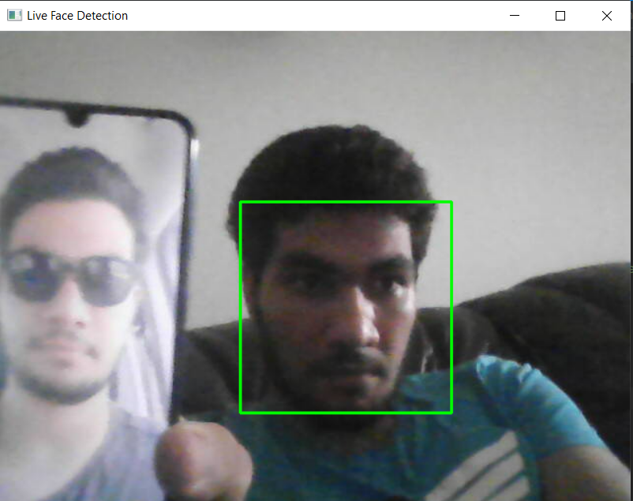
Face liveness detection

Slide 9
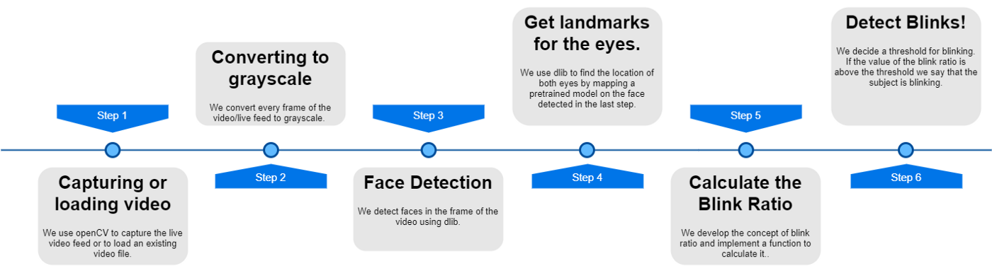
Face liveness detection
Approch 2
Our approach in this presentation is to build up the implementation incrementally. We present a series of steps that are individually easy to understand, describing, and adding functionality as we proceed.

Slide 10
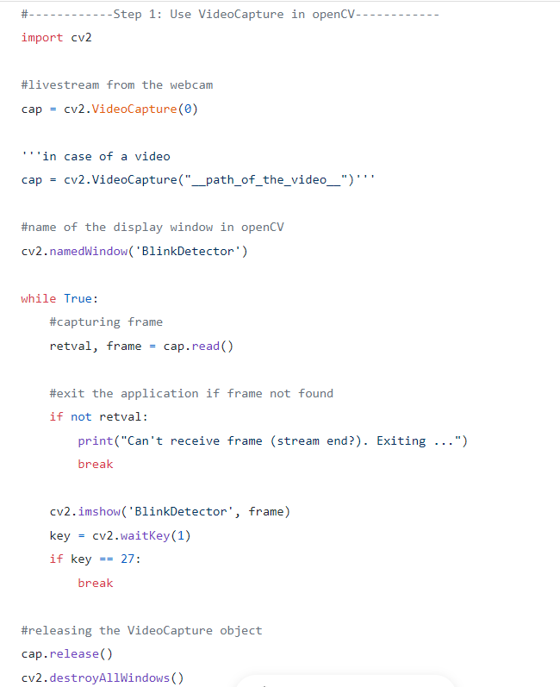
Face liveness detection
Step 1: Using OpenCV to load or capture video

Slide 11
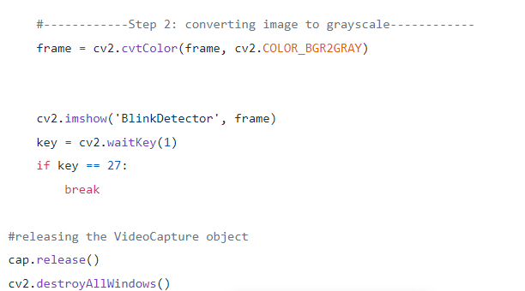
Face liveness detection
Step 2: Converting to the frames to grayscale
The frame we have captured is a 3-channel RGB colored image. We detect face and eyes in the frame. dlib’s face detection works perfectly fine on grayscale images as well as colored images. As grayscale image is a single channel image, we convert the frame to grayscale to reduce to the processing time required by further steps of the algorithm using cv2.cvtColor(frame, flag)

Slide 12
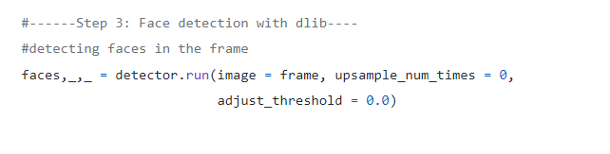
Face liveness detection
Step 3: Face Detection using dlib
We are now going to use dlib’s default face detector to detect all the faces in the image. This face detection model is based on HoG and SVM. We first load the detector using the get_frontal_face_detector()

Slide 13
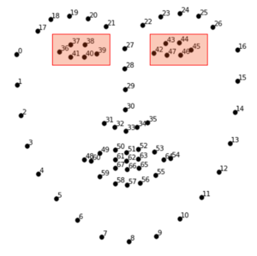
Face liveness detection
Step 4: Getting facial landmarks using dlib.
Well, to get started with blink detection we need to detect the eye first. We do this by using a pre-trained model which gives us 68 facial landmarks. We then map these landmarks on the face we detected in the previous step. We implement this in three parts. First, we load the contents of the pre-trained model in an object. Then we use this object to map the landmarks to the face detected in the frame and finally, we extract the Cartesian coordinates of these landmarks.

Slide 14
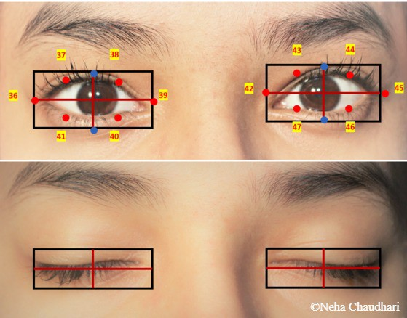
Face liveness detection
Step 5: Getting to know the Blink Ratio.
We are going to use the horizontal length to vertical length ratio of the imaginary bounding box of the eye. This is the BLINK RATIO
Blinking is the movement of eyelids. In our application, we quantify the movement of eyelids by using the vertical length. Hence, the vertical length reduces when the subject closes their eyes. As opposed to this, blinking does not affect the horizontal length. So, we assume it to be constant throughout the run-time. When we calculate the ratio of horizontal length to vertical length, the ratio increases if the vertical length reduces. So, we conclude that if the blink ratio crosses a certain threshold the subject must have blinked. This how we detect blinking.

Slide 15
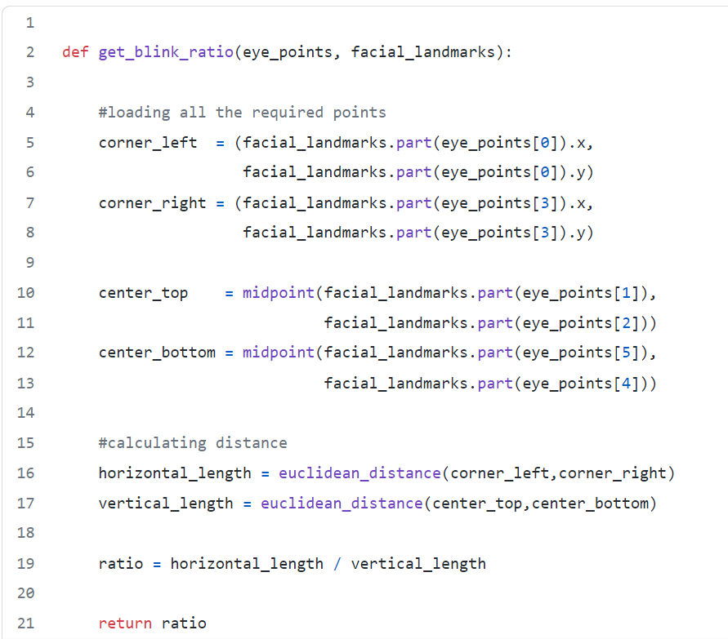
Face liveness detection
Step 5: Getting to know the Blink Ratio.

Slide 16
Face liveness detection
Step 6: Detect Blinks!
Now that we have calculated the blink ratio, we need to decide a threshold. We check for every frame if the blink ratio is above the threshold. If it is above the threshold, in our case we display a message on the OpenCV window.
Here the threshold to detect a blink is 5.7. This value was decided empirically.

Slide 17
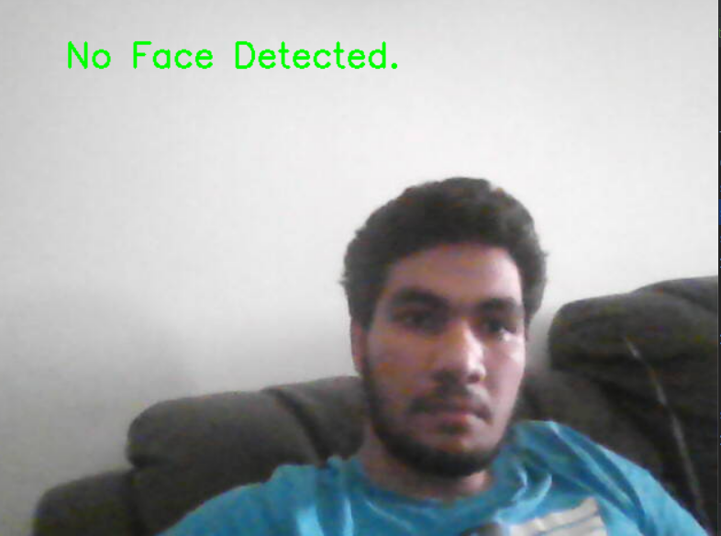
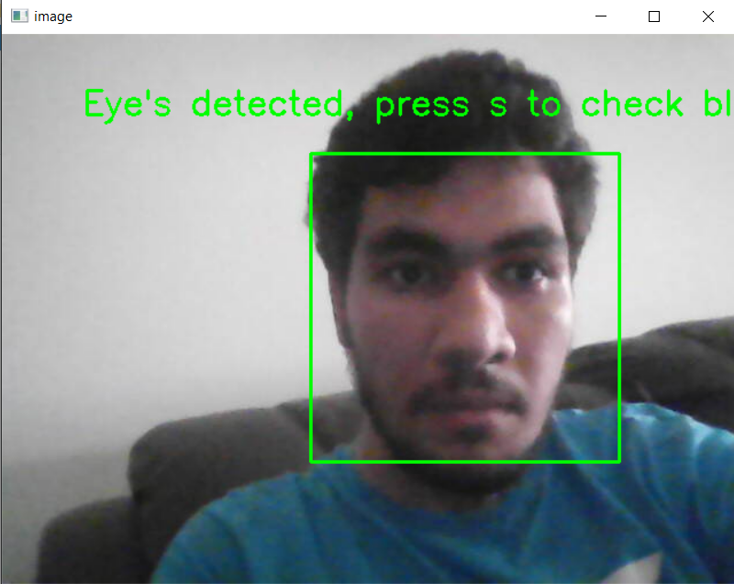
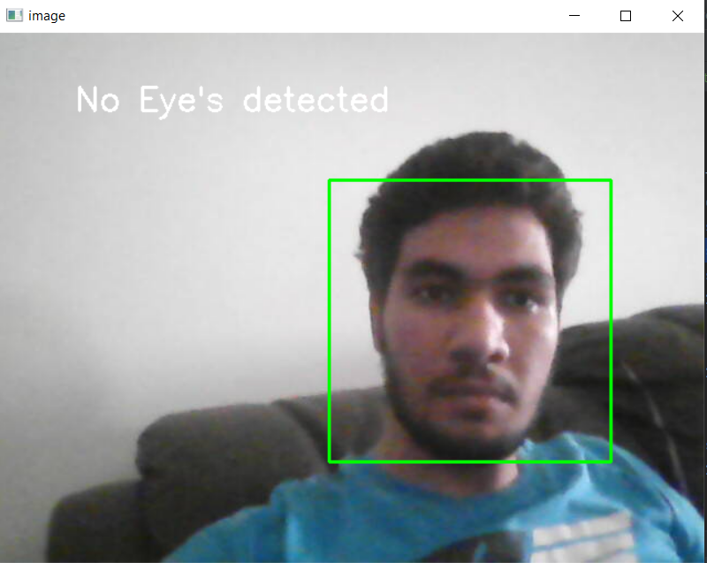
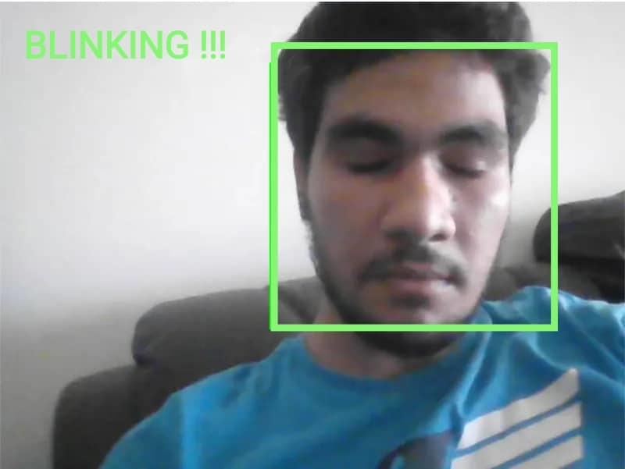
RESULT

